Slide 1
Database Concepts
Day 2

Slide 2
Agenda for Day 2
Discussion of Day 1 exercise
Designing a Database
  Normalization
  The ER diagram
Storing Data
  building a database from a model
Retrieving Data
Introduction to SQL
Day 2 Assignment

Slide 3
Review – Day 1
What is a Database?
Why use a Database?
Introduction to MS Access
Overview Relational Database
RDBMS
Situation Description
Model Entities, Attributes, Relationships

Slide 4
Review – Day 1 (cont)
Data Table Rules
    Table Names must be Unique.
    Column Names within a table must be Unique.
    Rows must be Unique.
    Columns must be Non-Decomposable.
    Columns and Rows can be in any order.

Slide 5
Review – Day 1 (cont)
Primary and Foreign Keys
Relationships
  One-to-One (1:1)
  One-to-Many (1:M)
  Many-to-Many (N:M)

Slide 6
Day 2
Designing a Database (Continued)

Slide 7
Normalization
Developed by Dr. E.F. Codd at IBM in 1970
A Progressive Refinement of Database Structures
Process for Assigning Attributes to Entities
Transforms Complex Structures into Simpler ones.
Goals:
  To Minimize Data Redundancy
  To Minimize NULL values
  Enable extension without needing major redesign
  Minimize modification anomalies
  Make queries easier and less limited

Slide 8
Normalization
Three main “Forms”
  First Normal Form (1NF)
  Second Normal Form (2NF)
  Third Normal Form (3NF)
Additional levels
  Boyce-Codd Normal Form
  Fourth Normal Form (4NF)
  Fifth Normal Form (5NF)
  Sixth Normal Form (6NF)
Only concerned with 1-3NF
http://en.wikipedia.org/wiki/Database_normalization

Slide 9
Normalization
Although Normalization is very important you should NOT assume that the highest level of Normalization (3NF) is ALWAYS the best
Higher levels of Normalization Introduce Performance Trade Offs
DENORMALIZATION is the process of converting a 3NF Model to 2NF

Slide 10
First Three Normal Forms
First Normal Form
No repeating columns.
Second Normal Form
Every non key column identified by the entire primary key
  This comes into effect when we have a multi-column primary key
Third Normal Form
Every non key column depends on only the primary key
  If a non-key column is uniquely identified by another non-key column it should be moved to a table that is keyed by that column

Slide 11
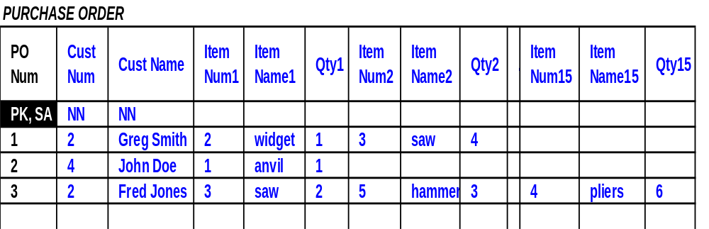
Each purchase order may have many items ordered
ITEM NUM, ITEM NAME and QTY are repeated many times based on the number of items ordered
To apply the 1st NF you need to remove the repeating columns and change the model

Slide 12
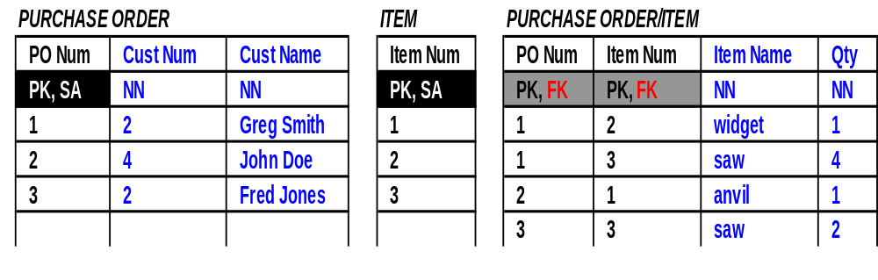
1st NF Applied
In this model there are no repeating columns; therefore, the tables are in the 1st NF
Now check for the 2nd NF
  Every non key column is identified by the entire PK
    In the PURCHASE ORDER/ITEM table the ITEM NAME refers to the ITEM NUM not the PO NUM

Slide 13
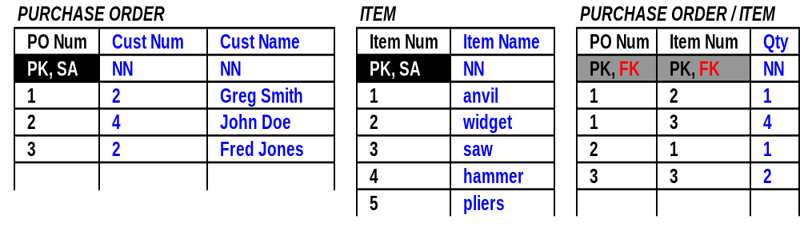
2nd NF Applied
Now the tables are in the 2nd NF
It is necessary to check for the 3rd NF
  Every non key column depends on the entire PK and nothing but that key
    In the PURCHASE ORDER table the VENDOR NAME depends on the VENDOR NUM not the PO NUM. So we need a separate table to keep the VENDOR information

Slide 14
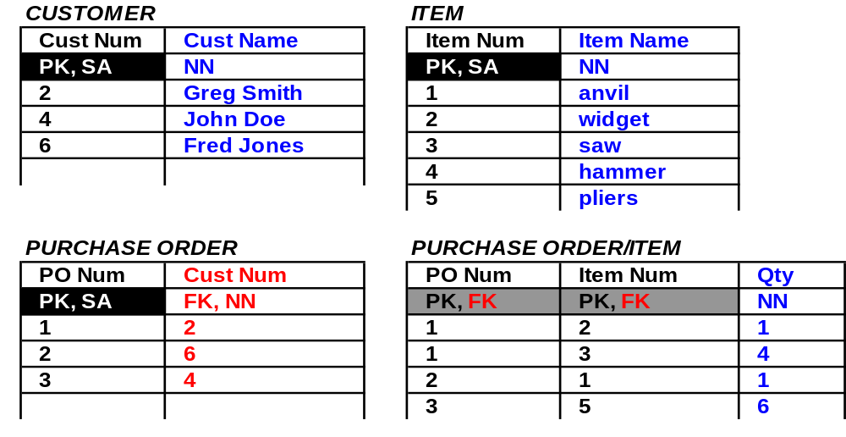
3rd NF Applied
By modeling to the 3rd NF you have added more tables and reduced nulls and data redundancy

Slide 15
Group Exercise
Get into your Groups
From the list of entities you identified for your database scenario, draw table models for each of the entities showing the primary keys and attributes for each entity.
Determine the relationships between the tables and the cardinality of those relationships and add the foreign keys to your tables
Normalize your Tables to 3NF

Slide 16
Day 2
Entity Relationship Diagrams

Slide 17
What is an ER Diagram?
A map of your database.
An overview showing all your tables with their relationships.
  A variety of formats.
  No single industry standard.
  Each company will have its own standard depending on the tool they use.

Slide 18
ER Diagram - Entities
Entities Depicted as Boxes
Entity Name Singular, Uppercase
Unique names
Avoid use of Reserved Words
Become Tables in the Database

Slide 19
ER Diagram - Attributes
Listed Below Entity Name
Traditional:
  “#” Unique Identifier (PK)
  “*” Mandatory Attribute
  “o” Optional Attribute
Visio:
  PK, FK Nomenclature
  Bold Font = Mandatory
Become Columns in the Database

Slide 20
ER Diagram - Relationships
Solid or Dashed Lines may link Related Entities
  Solid = Mandatory
  Dashed = Optional
Crows Feet Designate “Many” end of Relationship
Various ways to Depict Cardinality

Slide 21
ER Diagram – Traditional
PRODUCT
#* SKU
ProductName
o Description
* UnitPrice
* SupplierId
SUPPLIER
#* SupplierID
* SupplierName
o StreetAddress
o City
o Prov
* Phone
o Email

Slide 22
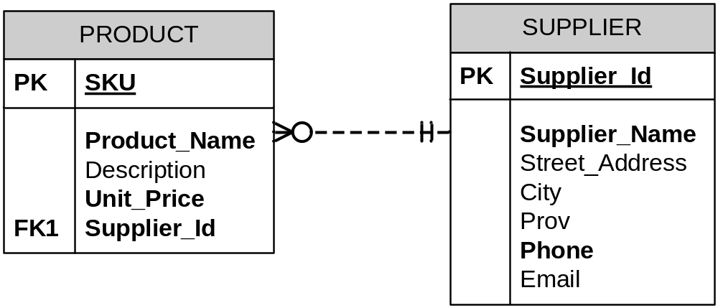
ER Diagram – Visio

Slide 23
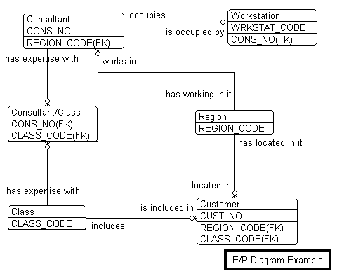
Example ER Diagram

Slide 24
Introduction to Visio
Demo
  Turning on crow’s feet on lines
  Reverse engineering E/R diagrams from existing databases

Slide 25
Day 2
Storing Data

Slide 26
Storing Data
Create a table
Customize columns
Enter data
Importing and exporting

Slide 27
Day 2
Retrieving Data

Slide 28
Finding Data
datasheet or form view
edit/find
search specific column or entire table

Slide 29
Sorting Data
text versus numeric sort
sorting on multiple fields
  move fields to adjacent positions
  sorts left to right

Slide 30
Filtering Data
Filter by column value
Filter using wildcards
  * - zero or more occurrences of any characters
  # - one numeric character
  ? – one alphabetic character
“Filter by Form”
Microsoft Access Version 2010 Step by Step
  Chapter 5
  Do practice exercise for “filtering information in a table”

Slide 31
Queries
Query by Wizard
Query by Design
query type
calculated fields with expression builder

Slide 32
Queries
Expression Builder Examples:
  Customer Name: [FirstName] & " " & [LastName]
  Total: ([Order Details]![UnitPrice]-[Order Details]![Discount])*[Order Details]![Quantity]

Slide 33
Day 2
SQL Overview

Slide 34
Structured Query Language
Referred to as SQL
Pronounced S-Q-L or Sequel
Language that is Processed by a SQL Engine in the RDBMS
Provides a way to View, Insert, Modify and Delete values from the Database

Slide 35
SQL – SELECT Statement
Retrieve data from One or More Tables of a Database
Data in the Database is NOT changed by a SELECT Statement
DATA Retrieved from Multiple Tables with a JOIN Statement

Slide 36
SQL Select - Example
Examples of select statements:
  SELECT {criteria} FROM {Table Name}
  [WHERE {criteria} ] [ORDER BY {Column
  Name [ASC | DESC]}
  SELECT * FROM Products
    * means all columns
    Omitting WHERE clause Returns ALL Rows
  SELECT ProductID, UnitPrice FROM Products WHERE (ProductID=123)
    Return the Named Columns in the Order Specified for ProductID 123

Slide 37
SQL Select – Example 2
Examples of Filtered SELECT Statements:
  SELECT * FROM Products
  WHERE UnitPrice > 10
    Select all Columns and Only Rows which Satisfy the Condition UnitPrice > 10
  SELECT ProductID, UnitPrice, TaxCode FROM Products WHERE UnitPrice > 10 ORDER BY UnitPrice DESC
    Select Named Columns and Only Rows which satisfy the condition UnitPrice > 10
    Sort rows in result set in Descending order by UnitPrice

Slide 38
SQL – INSERT Statement
An INSERT Statement Adds New Rows to Exactly One Table in a Database
Example of an Insert statement:
  INSERT INTO CreditCard (ExpiryDate, Balance, CreditLimit) VALUES ("31/12/2000", 500, 2000)
    an Insert Values adds one row to one table
    system-assigned columns must be ignored
    columns with default values may be ignored

Slide 39
SQL – UPDATE Statement
An UPDATE Statement Modifies Rows in Exactly One Table in a Database
Example of an UPDATE Statement:
  UPDATE Products
  SET UnitPrice = UnitPrice + .1, AvailableQuantity = 100
  WHERE ProductID > 10
    Update all rows of Products table that satisfy the condition ProductID > 10 (before update)
    In each row that qualifies to be updated, add .1 to the UnitPrice and set AvailableQuantity to 100

Slide 40
SQL – DELETE Statement
  A DELETE Statement Removes Rows from Exactly One Table in a Database
  Example of a Delete Statement:
    DELETE * from Products WHERE UnitPrice < 1
      Delete all rows from the Products table that satisfy the condition UnitPrice < 1

Slide 41
Assignment Day 2
Create an E-R Diagram for your group database scenario
  Please include at least 4 Entities and their relationships, with at least 4 Attributes each (with the exception of bridge entities which may have fewer attributes)
  Feel free to discuss your Design in your Groups
  EACH PERSON must Create their own Diagrams

